Slide 1
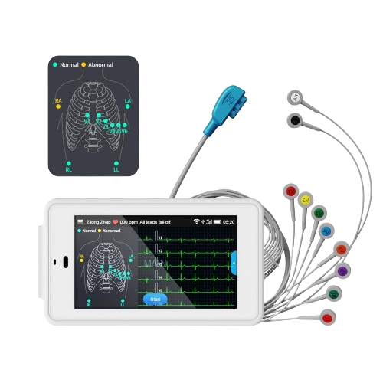
TODAY’S SESSION OUTLINE
ECG SIGNAL ANALYSIS WITH MATHLAB
02
Overview of ECG and Instrumentation
03
Biomedical Signal Processing Workflow
03
Demo Presentation and Practical

Slide 2
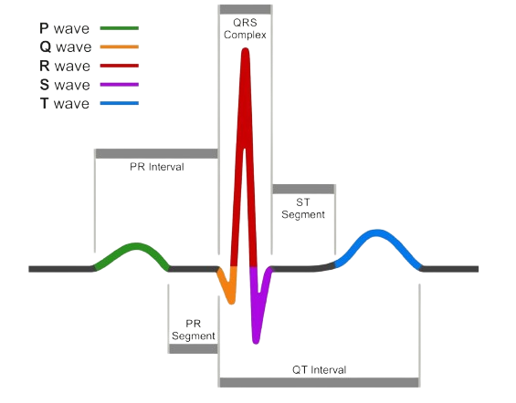
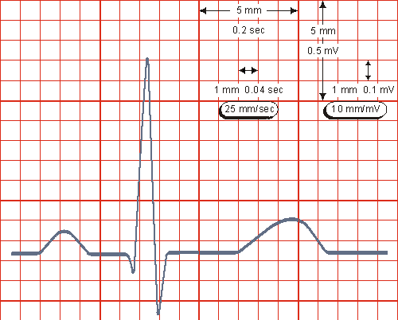
OVERVIEW OF ELECTROCARDIOGRAPHY
COMPONENTS
P wave, QRS Complex, T wave, U wave
BACKGROUND GRID
A small box is 1mm x 1mm (0.1mV x 0.04s)
A large box is 5mm x 5mm (0.5mV x 0.20s)
RATE AND RHYTHM
Absent P waves with “irregularly irregular’ QRS Complexes, Saw tooth pattern, sine wave pattern etc

Slide 3
BIOMEDICAL SIGNAL PROCESSING
Bio-signal Processing workflow
A
B
SIGNAL ACQUISITION
ARTIFACT REMOVAL AND PREPROCESSING
C
D
SIGNAL VISUALIZATION AND ANNOTATION
FEATURE EXTRACTION

Slide 4


PRACTICAL SESSION
Access source codes from my GitHub Repository
TITLE 01

